Slide 1


CSE 445 / 598
Distributed Software Development
Practical Demonstration
Of Developing a SMS
Guest Lecture by
Calvin Cheng

Slide 2

What is SMS?
SMS is the abbreviation for Short Messaging Service
It enables the use of cellular phones to send and receive “short” text messages.

Slide 3
Can we create a service to send SMS messages?
Yes, through the use of an email account (e.g. Gmail and Outlook Exchange).

Slide 4
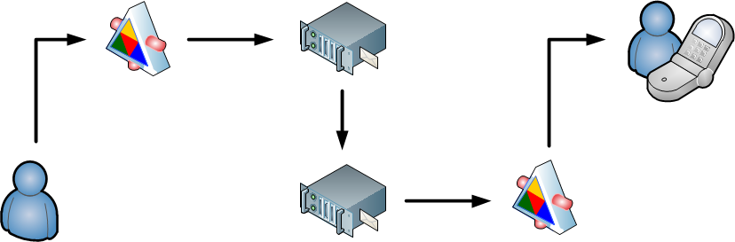
How Does SMS Service Work?
Gmail SMTP Service
SMS WCF Service
Carrier Provider SMTP Service
SMS Gateway Service

Slide 5
Prerequisite
Visual Studio 2010 or new version installed
Setup a Gmail account.
ASU email account will not work.
*If you have anti-virus application enabled on your computer, please disable port blocking on 25 and 587.

Slide 6
Step 1: Creating a WCF Service
Methods for the WCF service:
public bool SMS(string Gmail_Account, string Password, string Phone, CARRIER Provider, string Message);
- Gmail_Account : sender’s Gmail account
- Password: sender’s Gmail password
- Phone: receiver’s cellular number
- Provider: carrier provider (e.g. AT&T, Verizon)
- Message: SMS message

Slide 7
Carrier Provider Email Extension
T-Mobile
phone_number@tmomail.net
Sprint
phone_number@messaging.sprintpcs.com
Verizon
phone_number@vtext.com
AT&T
phone_number@txt.att.net

Slide 8
Creating a WCF Service (Cont’d)
private bool Mail(string Account, string Password, string Receiver, string Subject, string Body)
- Account: sender’s Gmail account
- Password: sender’s Gmail password
- Receiver: receiver’s email address
- Subject: subject line
- Body: message

Slide 9

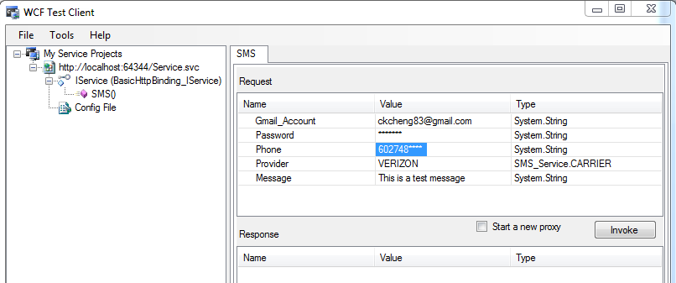
Step 2: Testing the WCF Service
Validate your service using WCF Test Client.

Slide 10
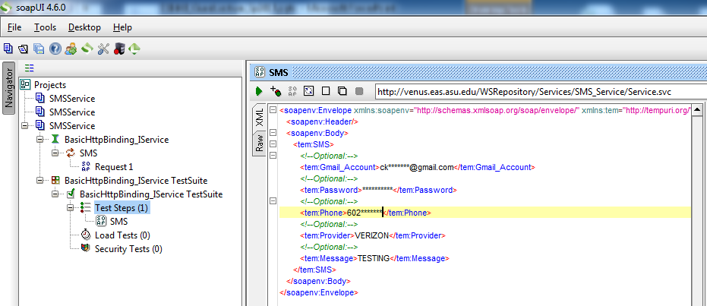
Alternative Testing Tool: SoapUI
Other alternative testing tools: http://www.soapui.org/
Allows you to create test cases.

Slide 11
Step 3: Creating the Presentation Layer
Windows Application
ASP .NET Page
Silverlight
Java Servlet
Java Applet
Java Script / AJAX / Jquery (HTML 5)

Slide 12
Accessing the WCF service
For demonstration purposes, we have posted a version of the WCF service on the ASU server.
You can access the WCF service using the link below:
http://venus.eas.asu.edu/wsrepository/services/SMS_Service/Service.svc

Slide 13
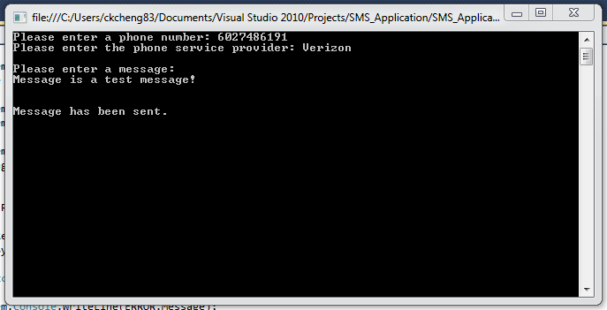
Console Application

Slide 14
Questions

